Slide 1
E-COMMERCE CALL CENTER ANALYSIS
OCTOBER
2020
DASHBOARD

Slide 2
CRISP-DM
E-COMMERCE Call Center company analyst data by using Cross-Industry Standard Process for Data Mining methodology followed below steps:-
Business Understanding
Data Understanding
Data Preparation
Modeling
Evaluation
Deployment

Slide 3
Business Understanding
The project aims to use data-driven methods to improve customer service, boost customer satisfaction and drive business growth. By analyzing past customer service data, the goal is to find patterns, trends, and areas for improvement, resulting in greater customer loyalty and operational efficiency. For better business understanding following points are given below :-
Customer Sentiment Analysis: Perform sentiment analysis on customer interactions. Identify positive, negative, and neutral sentiments expressed by customers to understand overall satisfaction levels.
Root Cause Analysis: Investigate common customer complaints. Pinpoint recurring problems to address them proactively and prevent future escalations.
Service Response Time Analysis: Analyze response times for customer queries and support requests to assess the efficiency of the customer service team.
Customer Segmentation: Segment customers based on their demographics, behavior, and preferences. Understand different customer segments' needs and pain points to tailor services and communications accordingly.
Trends and Patterns Identification: Identify patterns and trends in customer service data to uncover opportunities for process improvements and innovative service offerings.

Slide 4

Data Understanding
After gaining a thorough understanding of the business requirements, we accessed the data to explore it further, aiming to identify any errors or repetitions. These are columns involved in business understanding are as follows:

Slide 5
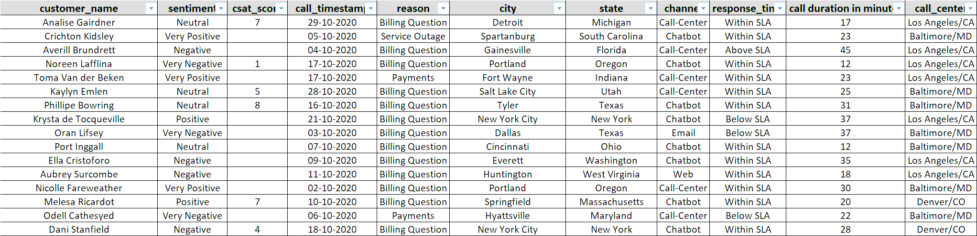
Data Preparation
After completing the phases of business understanding and data understanding, we conducted “Data Preparation”. During this phase, we filtered the data for analysis and performed data cleaning tasks such as formatting corrections are as followed:-

Slide 6
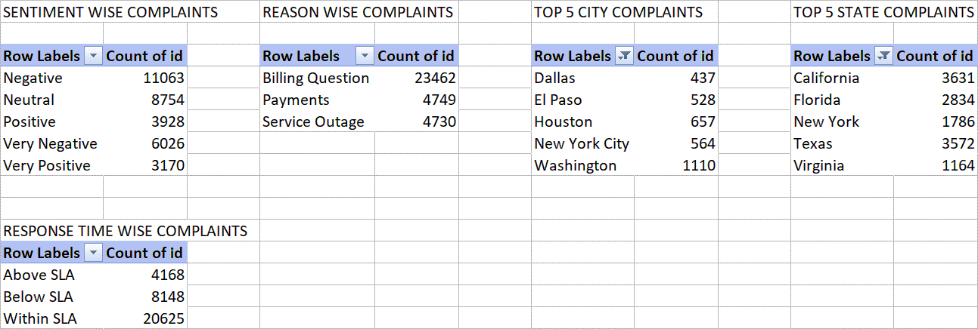
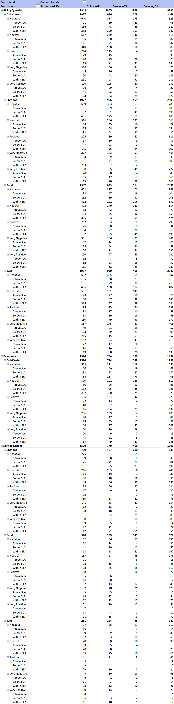
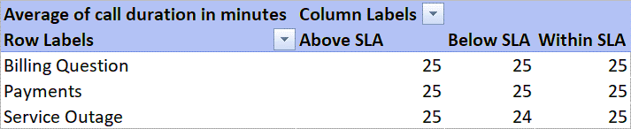
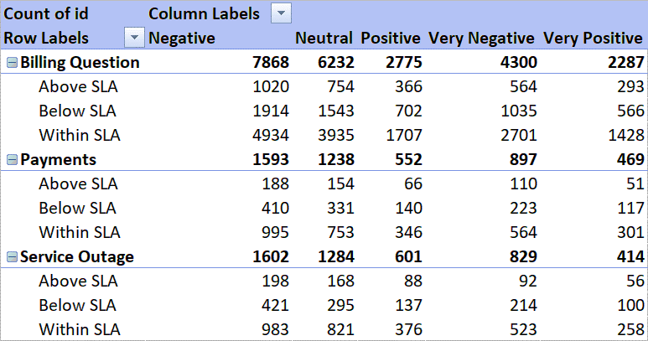
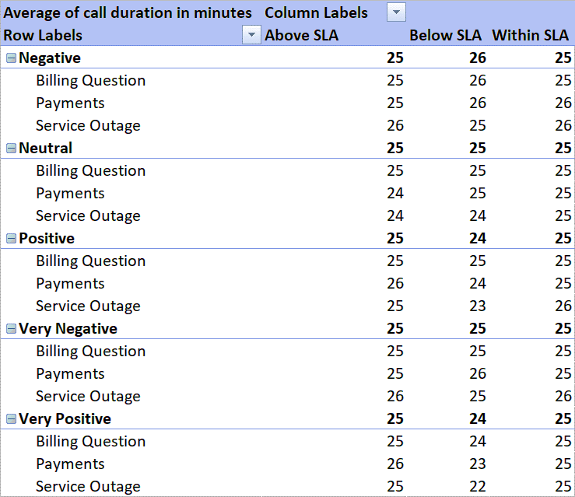
Modeling
ROOT CAUSES ANALYSIS BY PIE
CUSTOMER SEGMENTATION
SERVICE RESPONSE TIME ANALYSIS
TRENDS AND PATTERNS IDENTIFICATION
In modeling, we select various techniques like pivot tables based on our data aligns with our objectives, to achieving specific goals are as follows :-
CUSTOMER SENTIMENT ANALYSIS

Slide 7
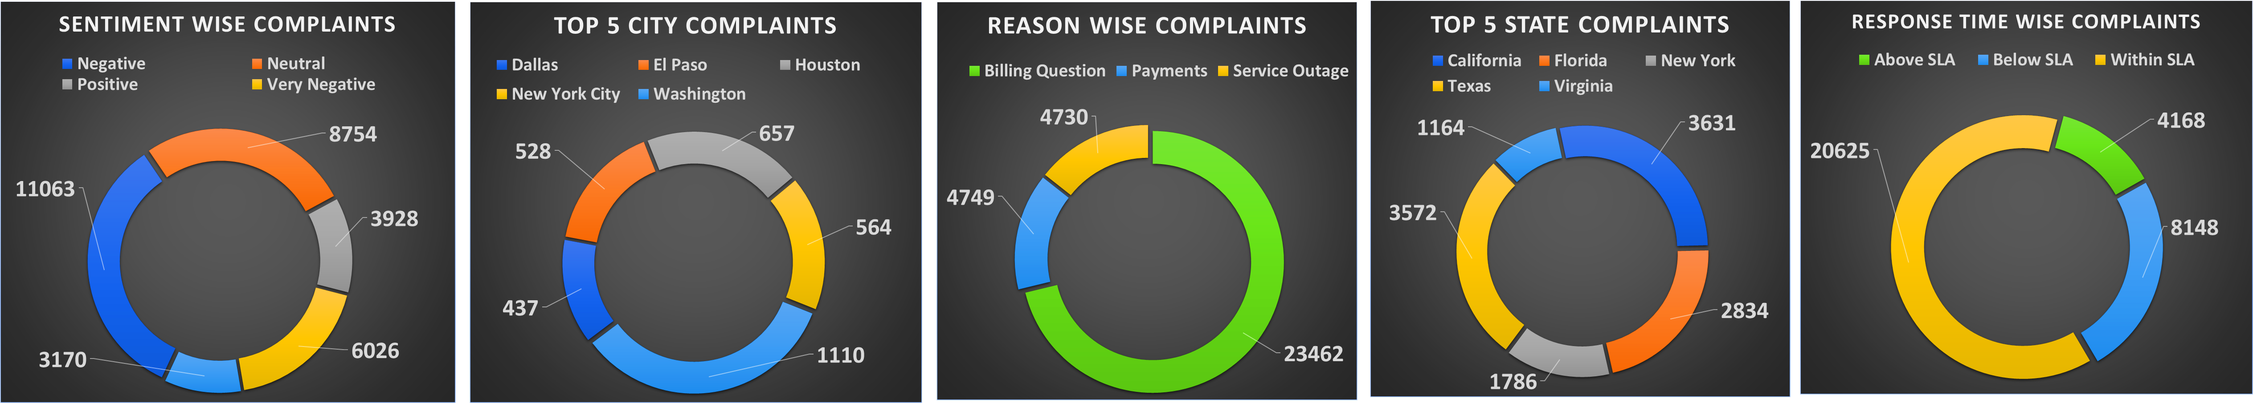
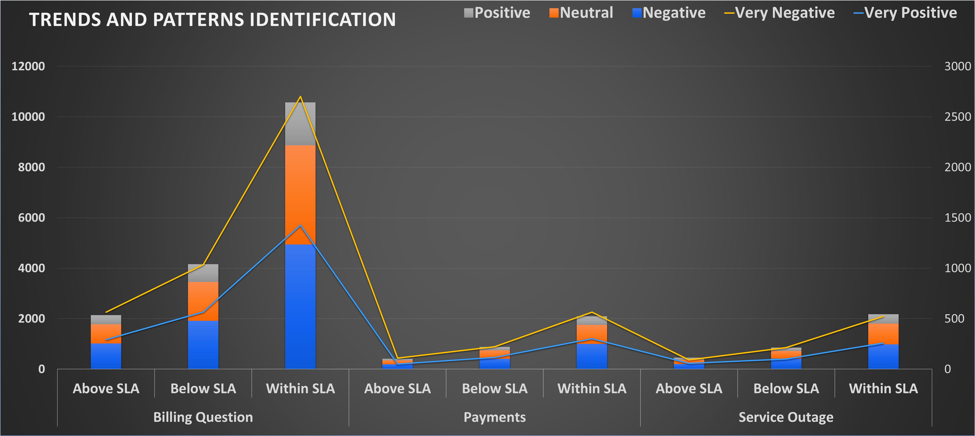
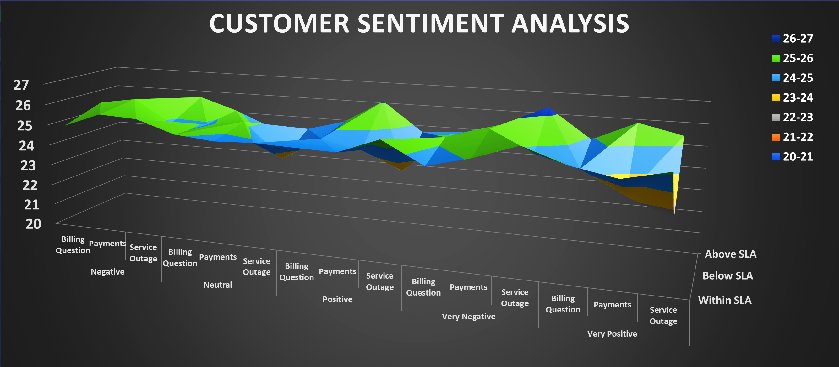
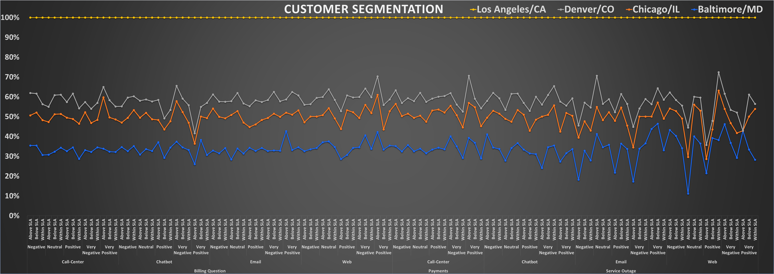
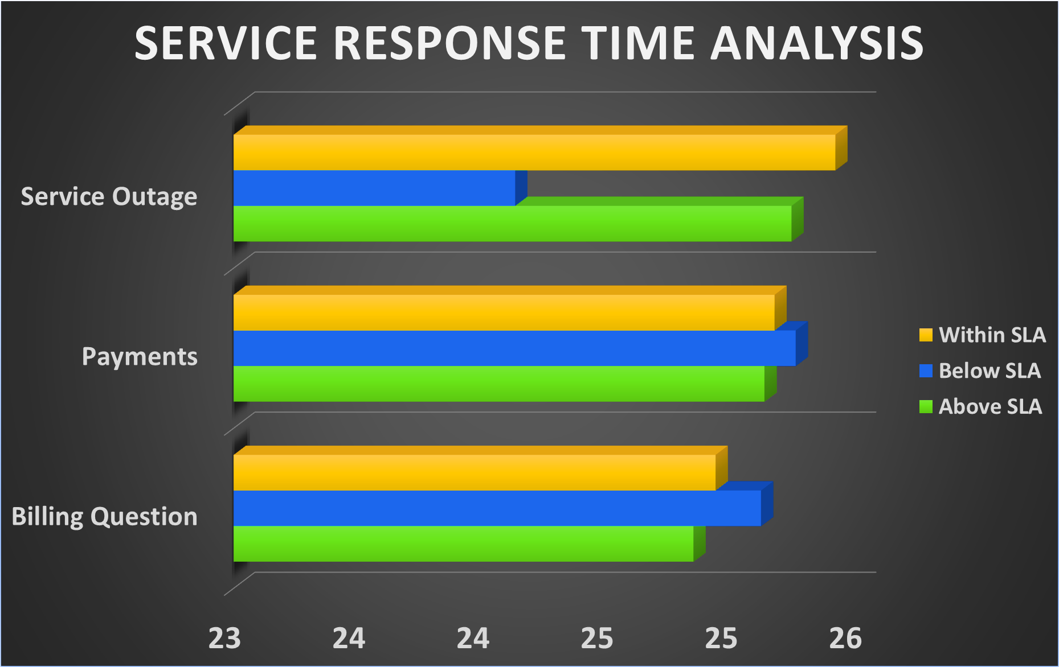
Evaluation
ROOT CAUSES ANALYSIS BY PIE
TRENDS AND PATTERNS IDENTIFICATION
CUSTOMER SENTIMENT ANALYSIS
After modeling, we elevate the performance of models by utilizing various types of charts such as bar charts, pie charts, and combo charts to summarize the data for insights are as follows :-
CUSTOMER SEGMENTATION
SERVICE RESPONSE TIME ANALYSIS

Slide 8
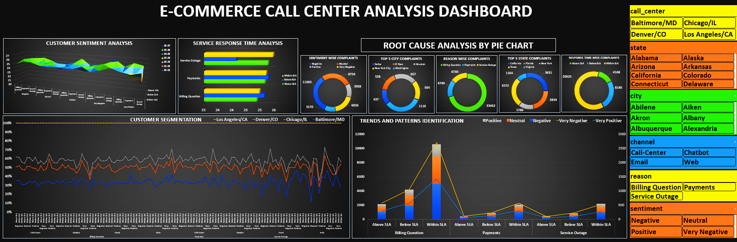
Deployment
By using above Modeling & Evaluation have made an E-COMMERCE CALL CENTER ANALYSIS DASHBOARD for Nile's as, he want Real-time monitoring dashboard for tracking all the Project Goals .This will also help to compare different models and identify the best one for the situation.

Slide 9
Recommendations
By observing the above dashboard now we can recommend Nile as follows :-
Customer Sentiment Analysis: Improving response times for billing questions and service outages, especially in the 22-23 sentiment range.
Root Cause Analysis: Improve response times to resolve complaints more quickly by streamlining your processes and ensuring that agents have the resources they need to do their jobs effectively.
Service Response Time Analysis: Focus on improving response times for billing questions and payments, as these areas have the highest percentage of complaints above the SLA.
Customer Segmentation: Improve by identifying the most frequent and negative complaints by city and reason, then focusing on improving response times in those areas.
Trends and Patterns Identification: Very Negative sentiment, with areas for improvement in response times, billing questions, payments, and service outages.

Slide 10
THANK YOU!

